Slide 1
Automatic RNA secondary structure prediction with a comparative approach
Fariza Tahi , Manolo Gouy , Mireille Re´gnier
Computers and Chemistry 26 (2002) 521–530
Speaker: Chia - Hung Chang
Date: Dec. 11, 2007

Slide 2
Abstract
This paper presents an algorithm, DCFold, that automatically predicts the common secondary structure of a set of aligned homologous RNA sequences. It is based on the comparative approach. Helices are searched in one of the sequences, called the ‘target sequence’, and compared to the helices in the other sequences, called the ‘test sequences’. Our algorithm searches in the target sequence for palindromes that have a high probability to define helices that are conserved in the test sequences. This selection of significant palindromes is based on criteria that take into account their length and their mutation rate.

Slide 3
Abstract (cond’)
A recursive search of helices, starting from these likely ones, is implemented using the ‘divide and conquer’ approach. Indeed, as pseudo-knots are not searched by DCFold, a selected palindrome (p, p’) makes possible to divide the initial sequence into two sequences, the internal one and the one resulting from the concatenation of the two external ones. New palindromes can be searched independently in these subsequences. This algorithm was run on ribosomal RNA sequences and recovered very efficiently their common secondary structures.

Slide 4
Input & Output
Input
  The input of DCFold is a set of aligned sequences. One is the target sequence and the others are the test sequences.
Output
  The output is a set of structural palindromes characterized by their position in the target sequence and their length.

Slide 5
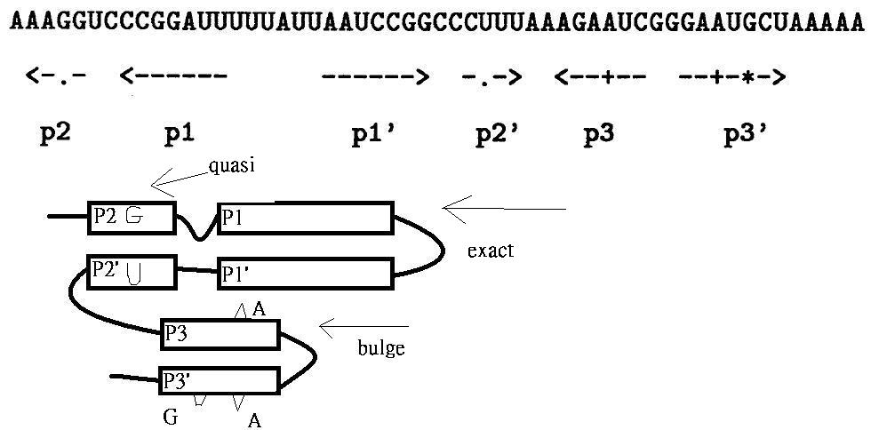
Palindromes

Slide 6
Method
Input S → S_{e1}+P+S_{i}+P’+S_{e2} , where (P,P’) is a palindrome.
Using divide and conquer approach.
(P,P’) then used as “anchoring points”.
Recursive call stops when:
  1.the sub-sequence is too small.
  2.no anchoring points is found.

Slide 7
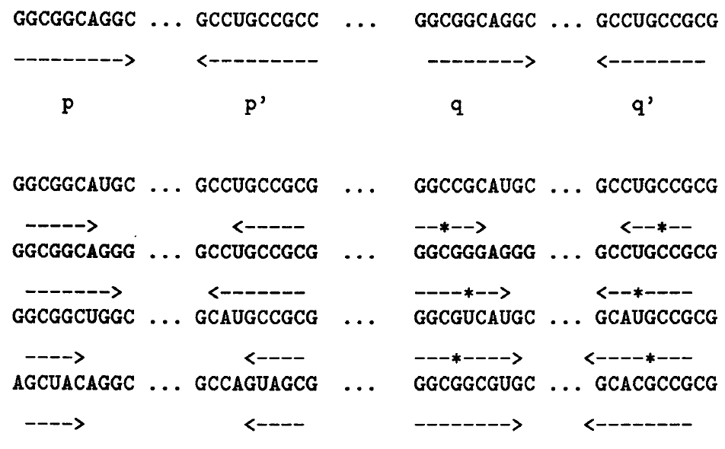
Conserved palindrome

Slide 8
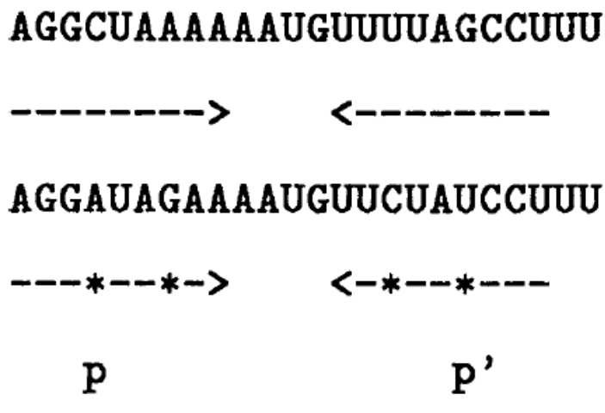
Palindrome selection criteria
Length
  lmin >= log_{k}n
Compensated mutations
  Mutation rate =
  # of mutations / length
  → length + # of mutations
  >= 2 lmin
Compensated mutations:
The pairing of the palindrome
bases still remains possible

Slide 9
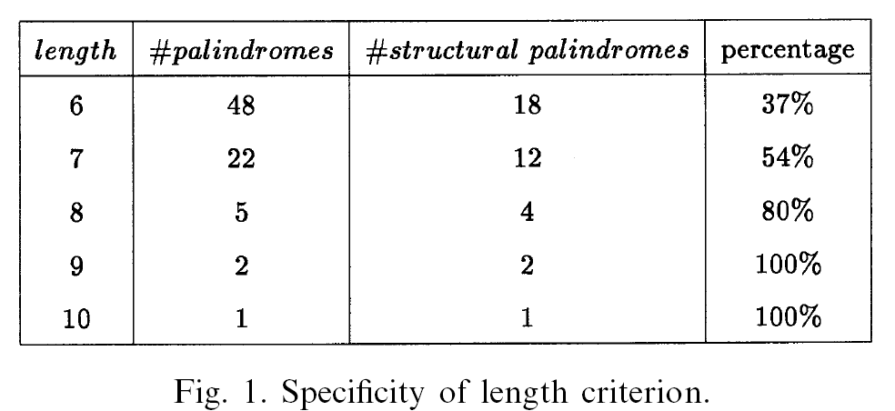
Length criterion

Slide 10
Palindrome search (detailed)
Build a suffix tree and search repetitions in linear time.
Approximate palindromes are not allowed.
Break them into several small helices without bulges and internal loops instead.

Slide 11
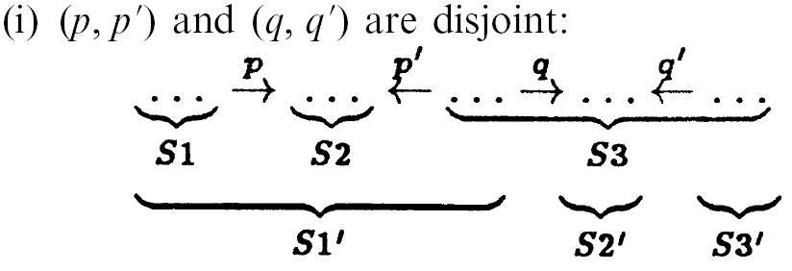
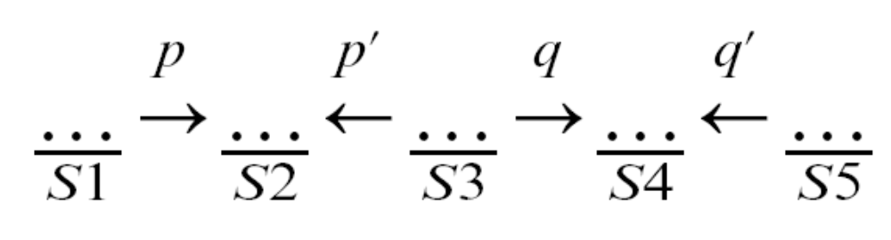
Recursive call order

Slide 12
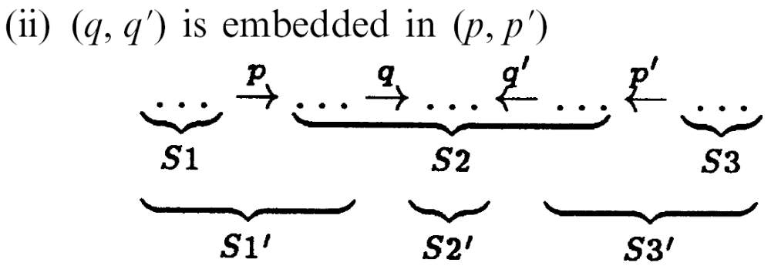
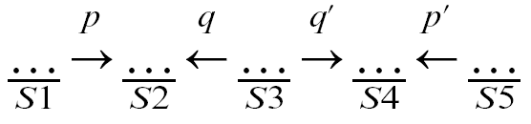
Recursive call order (con’d)

Slide 13
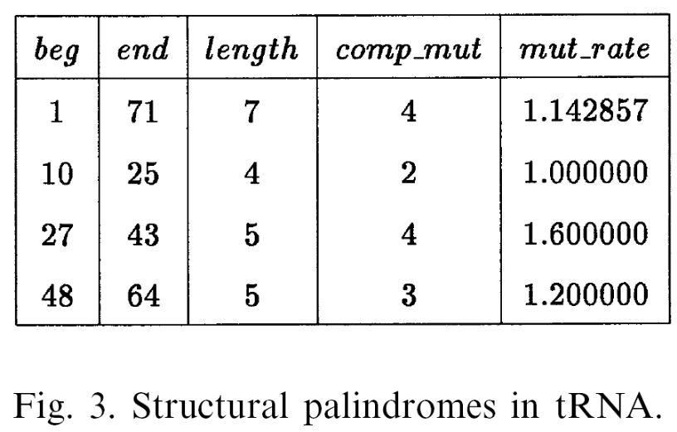
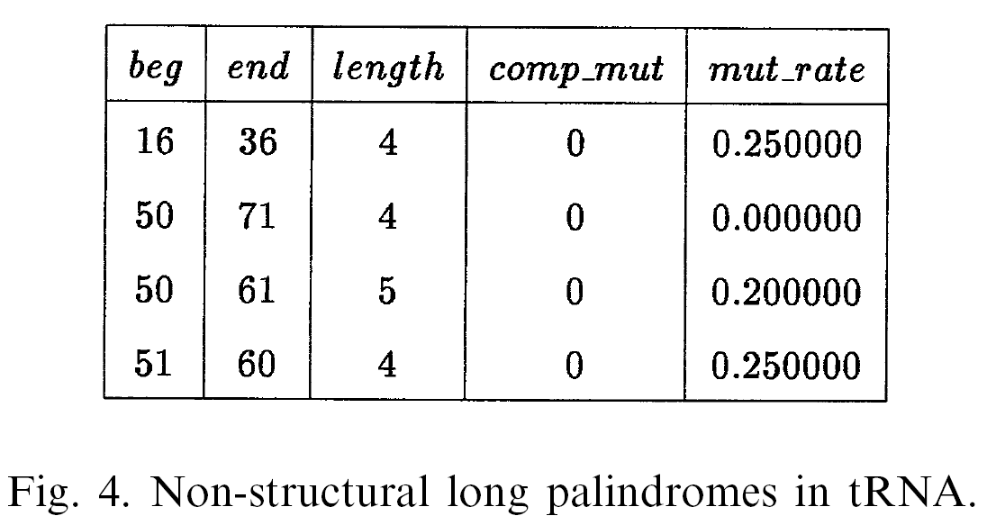
Result
Time complexity: O(nmk)
tRNA

Slide 14
Discussion
The results depend on the set of test sequences used and the alignment quality.

